Slide 1

Team: Ematics
Project: HealthCare System Based on Pictures of Eyes

Slide 2
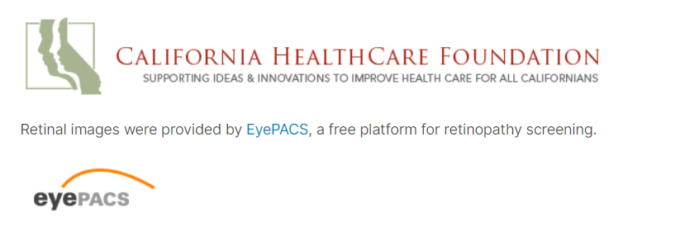
Problems
Address the imbalance of Healthcare Personal and Doctor Shortage
Save Life by Alerting the Insulin intake for critically endangered patients
Identifying the Patients who are unsure about their Diabetics Status
Innovation
We added revolutionary technology of advance AI/ML Algorithms to address this Problem
Based our Project on Research Paper “Effects of Diabetes on Ocular Health”
Our Dataset is from California Healthcare Foundation

Slide 3
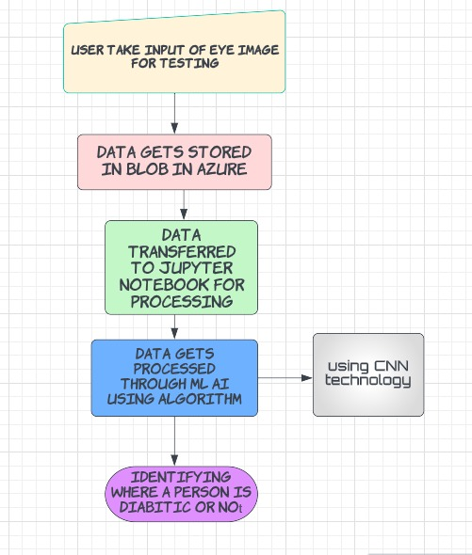
Flow of the Project

Slide 4
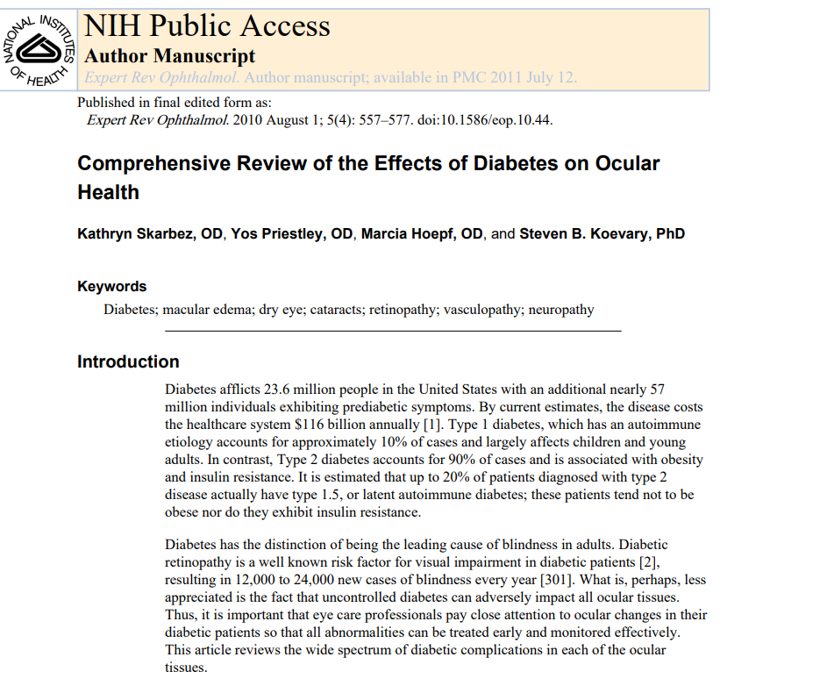
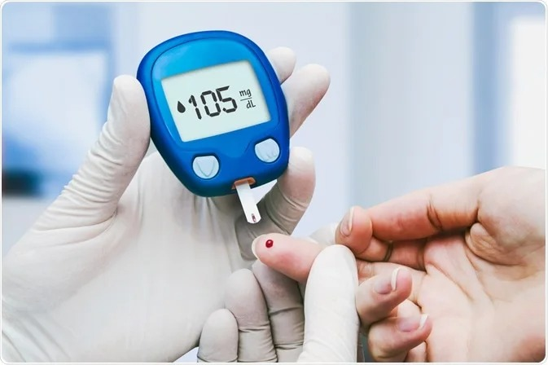
Research Paper on Effects of Diabetes on Ocular Health
Realistic
A Project is worthwhile when it address the Problems of People…..
“ Our Mission is to save life and address the imbalance of Healthcare Personal and Doctor Shortage“
It is inconvenient and painful process to examine diabetics test so with the help of this demonstration it makes everyone’s life easy.
Our project has achieved an amazing accuracy of about 90% correct prediction.

Slide 5




Tech Stack
Web Development Stack
HTML
CSS
Bootstrap
VCS (Version Control System)
Git/GitHub
Azure
Blob Storage Service
Jupyter Notebook Azure ML Service
AI/ML Tech
Machine Learning
Artificial Intelligence
Python
CNN/Algorithm

Slide 6
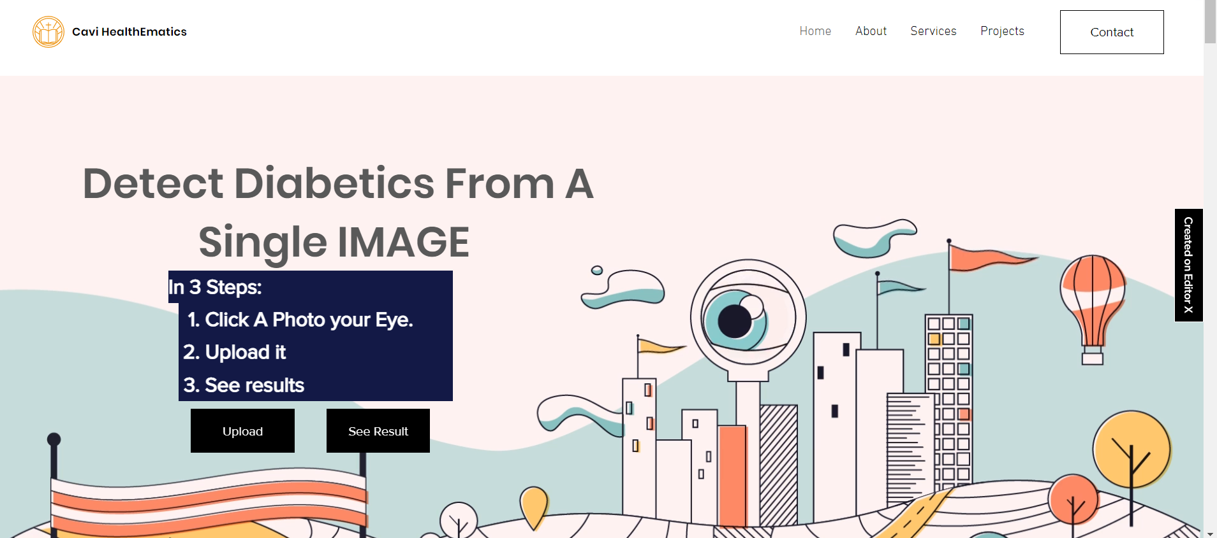
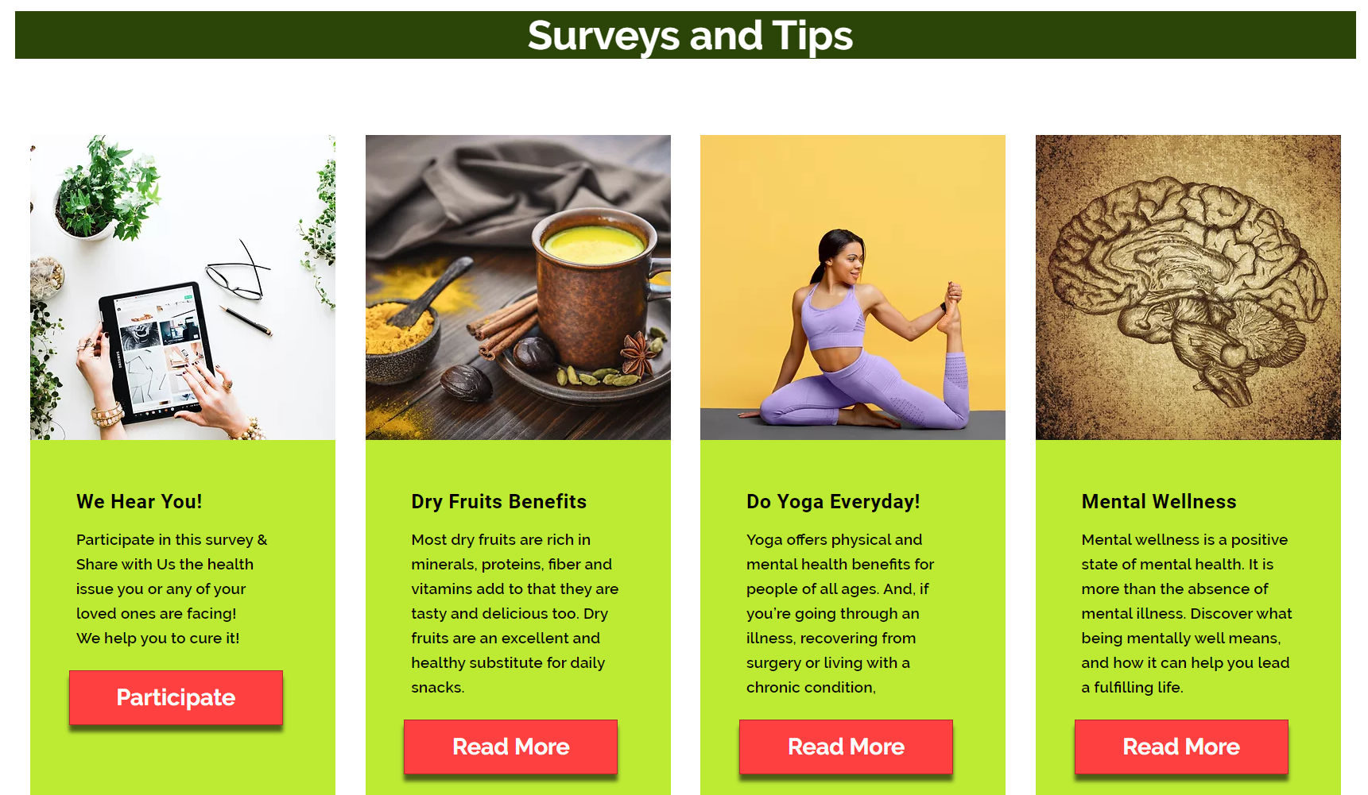
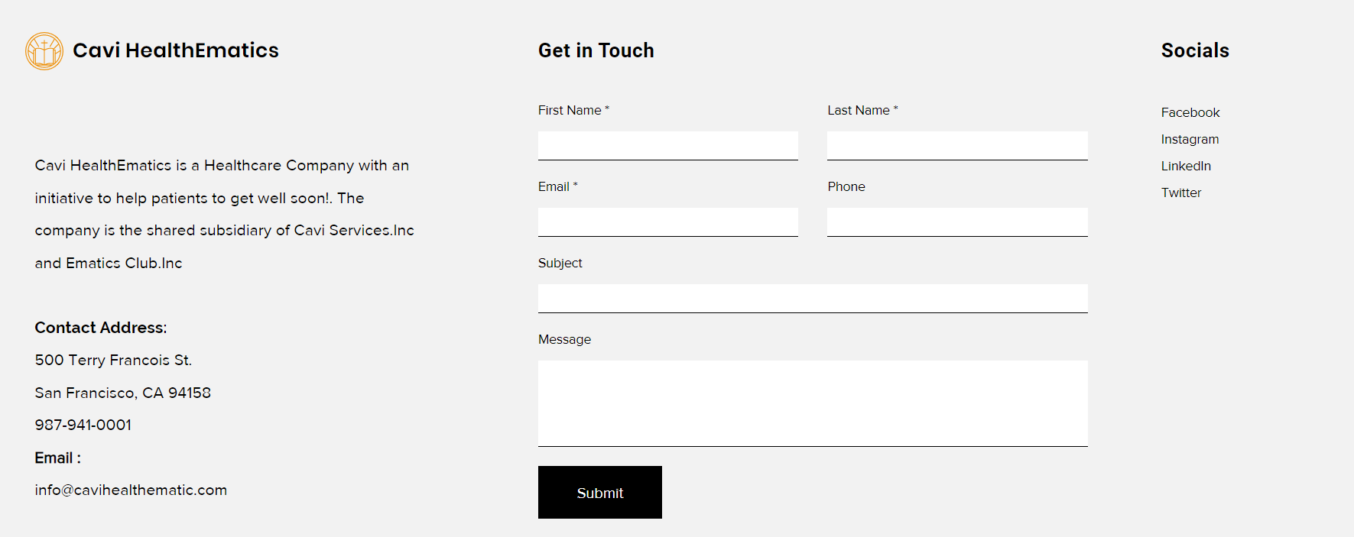
Our Project Website
Introduction of Data into System
Our Suggestions for Healthy Lifestyle
Our Response and Feedback Section

Slide 7
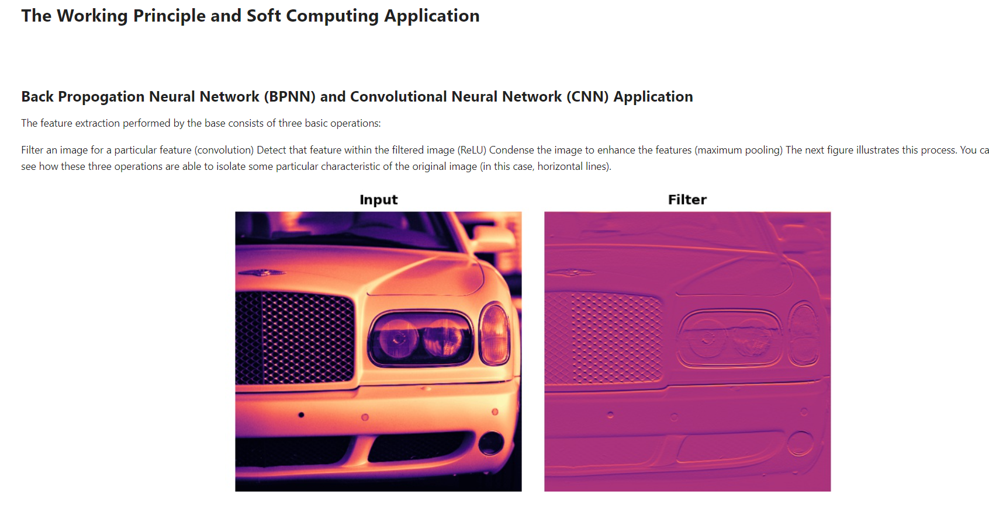
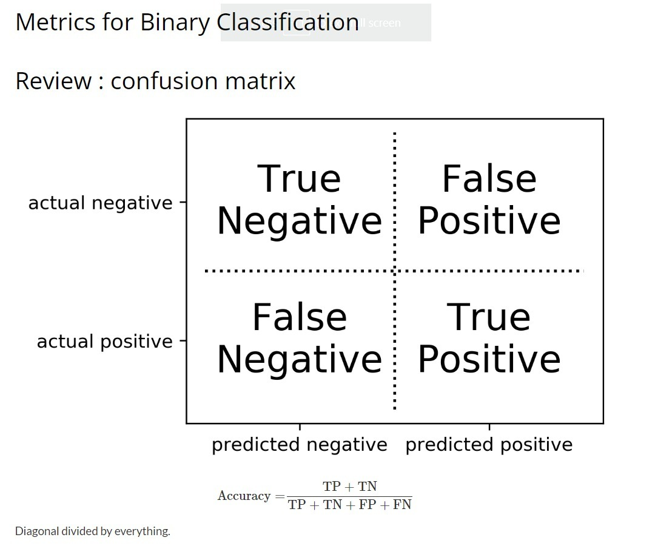
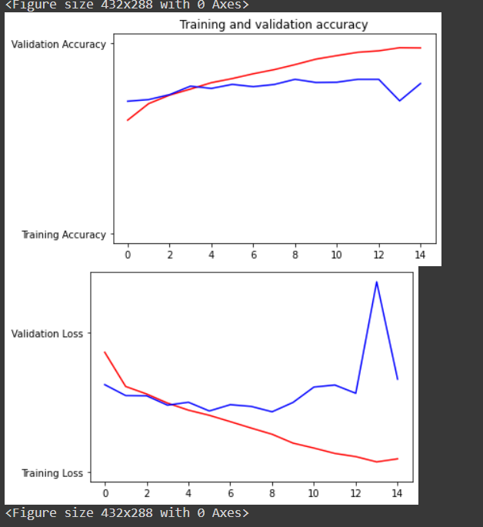
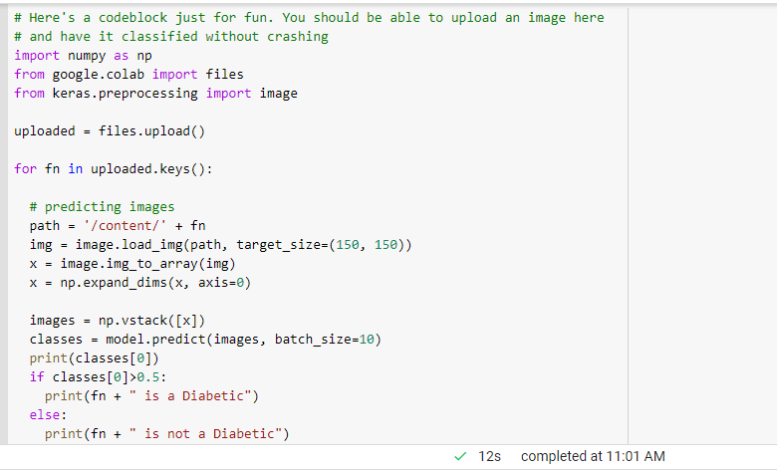
Algorithms | Live Demonstration
Confusion Matrix
Our Algorithm Performance
Main Algorithm

Slide 8
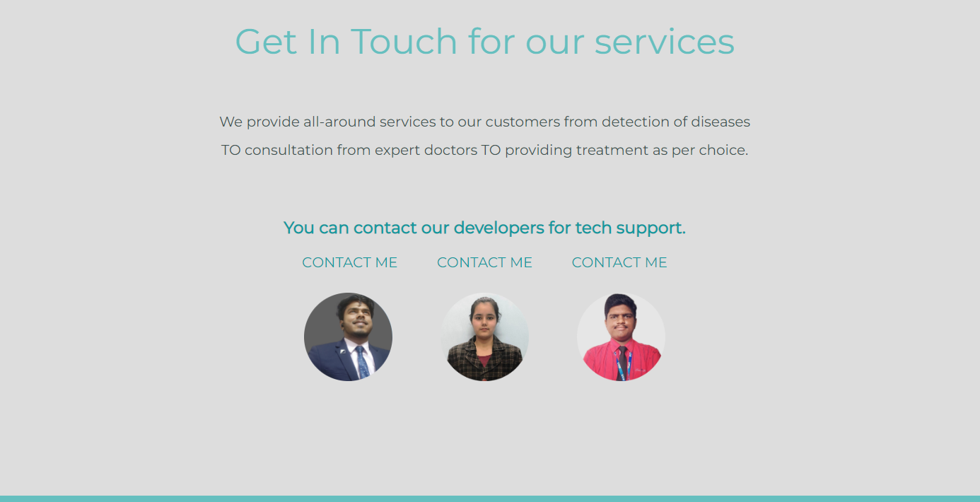

Slide 9

Any Questions?

